Slide 1
Arduino Workshop #2
Digital and Analog Inputs
Notes:
24 – Arduino Uno
24 - Small bread board
24 – Jumper wire sets
24 - 10 kΩ potentiometer
48 – 10 kΩ resistor
72 – 220 Ω resistor
24 – USB cables
24 – photoresistors
24 - TMP36 temperature sensor (or any other 5 V analog sensor)
24 – 5mm common-cathode RGB LED

Slide 2
Reading Digital Inputs

Slide 3
PowerPoint and Code
Github.com/EELabMan
Go To Repositories and find Arduino 2 Digital and Analog Inputs

Slide 4
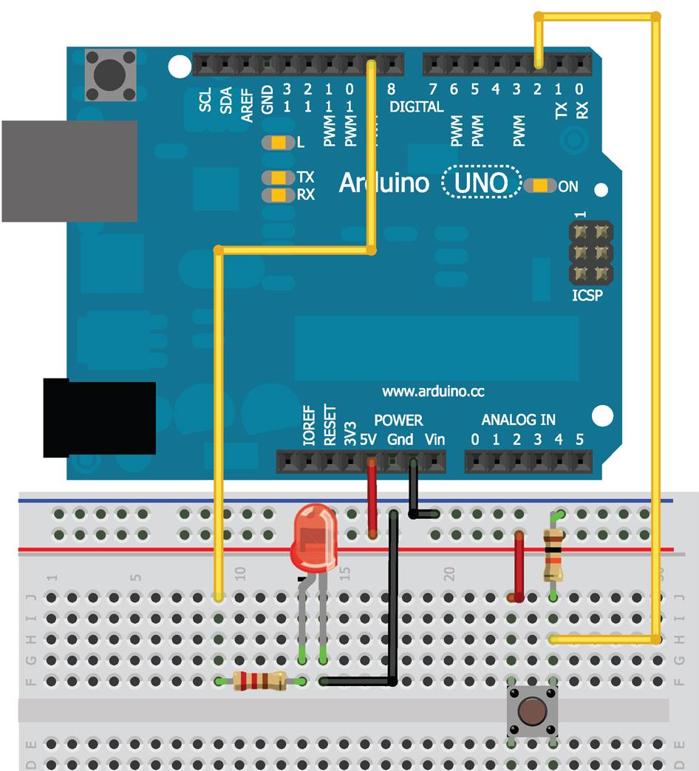
Wire diagram

Slide 5
Pull down resistor
Notice the resistor running from the button to the ground
This is a pull down resistor
5 v can run two paths
When the button is not being pressed it runs through the resistor to ground
When the button is pressed it runs through the button to ground
This insures that
The button does not create a short
The input pin is never in a floating state

Slide 6
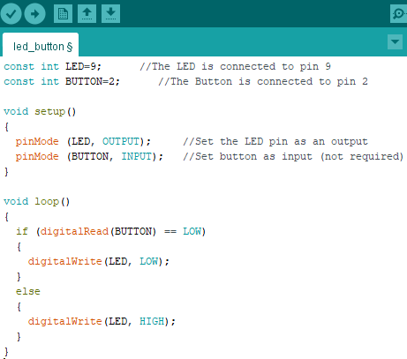
Download led_button.ino
Notice:
If button is
Pressed
digitalRead() returns HIGH
Not being pressed
digitalRead() returns LOW
When did you have to last hold the button down to keep a light on?

Slide 7
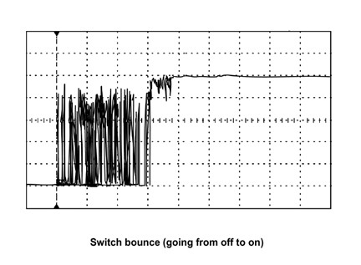
Bouncy buttons
Bouncy button means when you press the button the volatge bounces up and down before it settles to the high state.
This would turn something on and off several times.
We can program a small delay to help combat this issue.

Slide 8
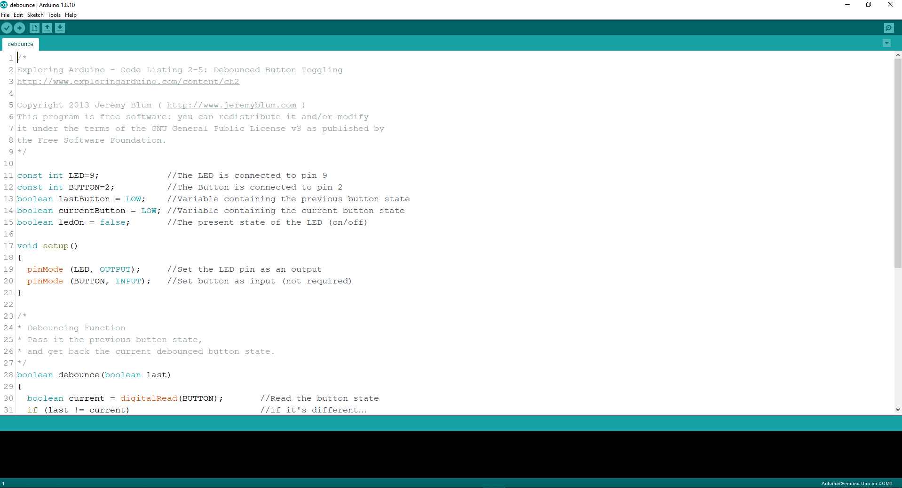
Download debounce.ino
Upload to the Uno and test the button for bounciness

Slide 9
How it works
Stores the state of the button
Initialized to LOW
Reads the current state
If the current state differs from the previous state
Waits 5 ms (button must have changed states)
Rereads the button and uses that as the current state
If the previous state was low and current state is high
Toggles the led state
Set the previous button state to the current button state
Repeats from step 2

Slide 10
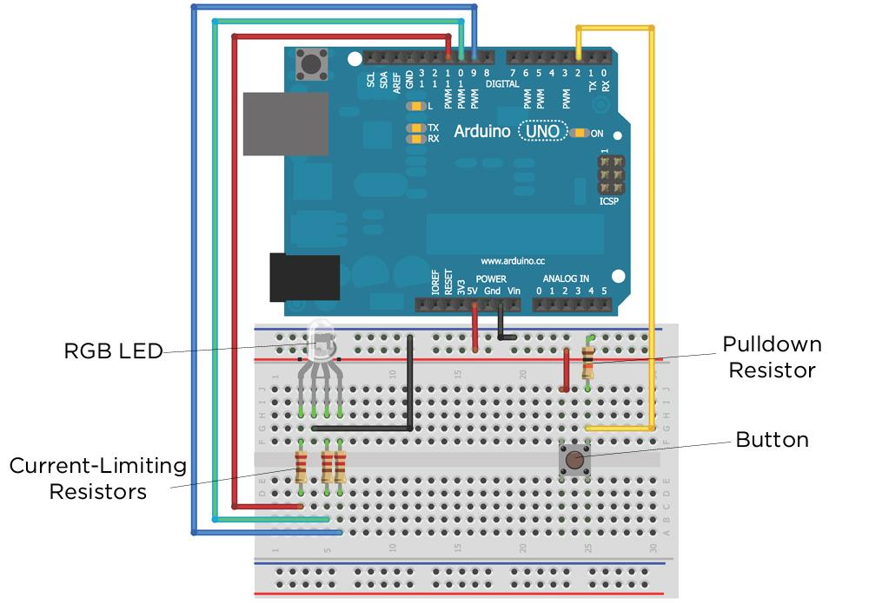
Diagram

Slide 11
Download RGB_nightlight.ino
Download from the github page.
Upload to Arduino and test its function.

Slide 12
Reading Analog Sensors

Slide 13
Why we still need analog in a “digital world”?
Observable features are analog
they can assume any number of potential states
Color of sunlight
Temperature
Concentration of contaminants in the air
So we need a way to distinguish between analog and digital inputs and convert between the two

Slide 14
Analog to digital converter (ADC)
Suppose you want to measure the brightness of the room (measured in lux - it could be any decimal from 0 to ∞)
Pitch black - output 0 volts
Completely saturated - outputs 5 volts
Half saturated - outputs 4.5 volts
⅓ saturated - outputs 1.6666 volts
etc.
You need to use the analog to digital converter (ADC) built into the Arduino to read this value

Slide 15
But what is a ADC doing?
In the Arduino
10-bit ADC
This means that the ADC can subdivide (or quantize) an analog signal into 2¹⁰ different values
2¹⁰ = 1024
So from the reference voltage (5 v)
2.5 v is mapped to 512 (½ of 1024)
1.25 v is mapped to 256 (¼ of 1024)
etc.

Slide 16
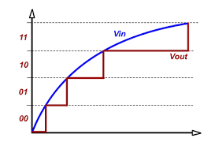
Visual of what’s happening
Here is a 2 bit ADC, it has 2 bits of resolution and therefore 4 total logic levels (2² = 4)
The higher the resolution the more “steps” in the digitized signal (remember the Arduino has 10 bit resolution… so 1024 steps)

Slide 17
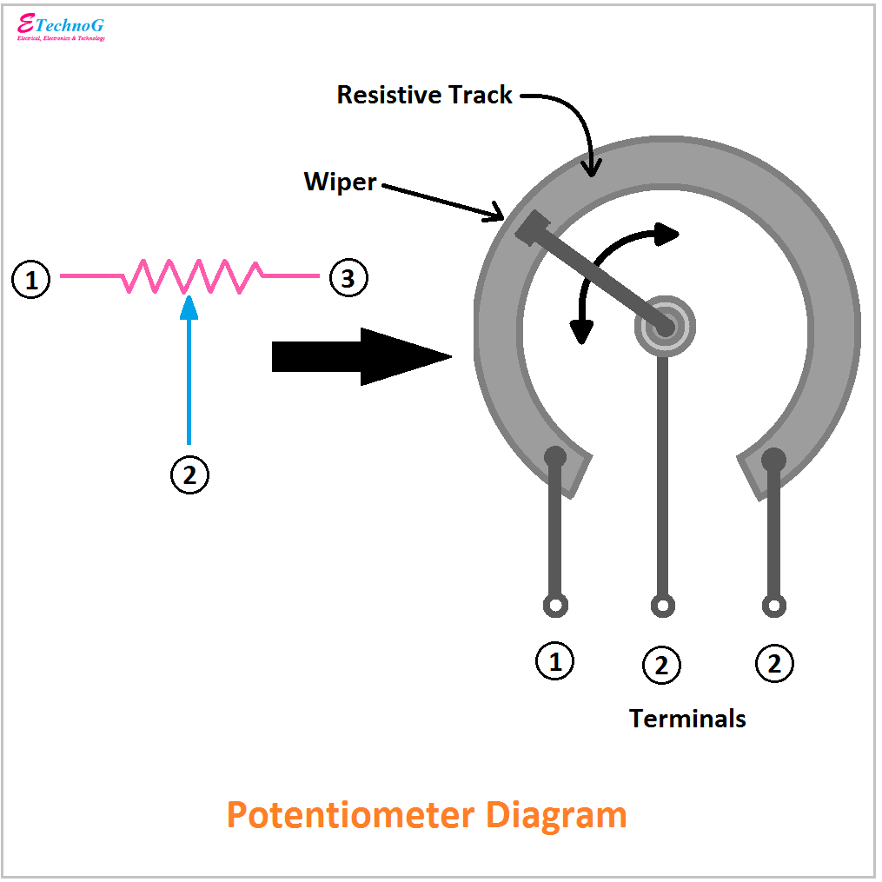
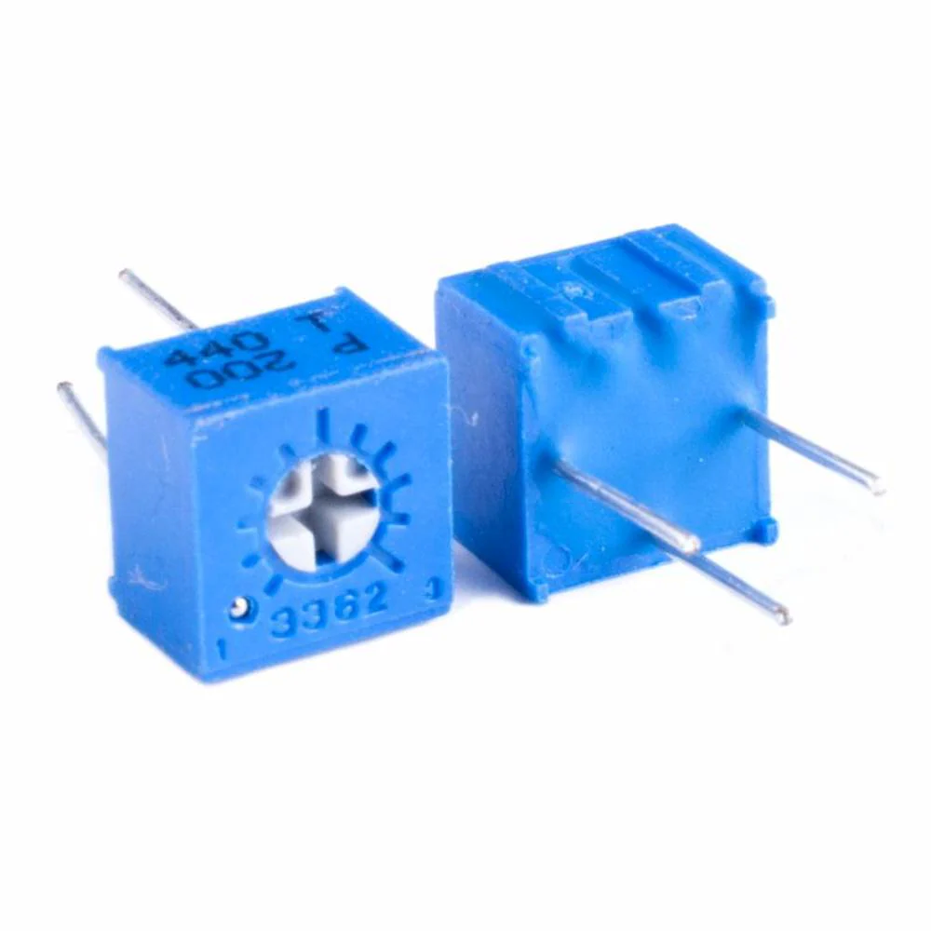
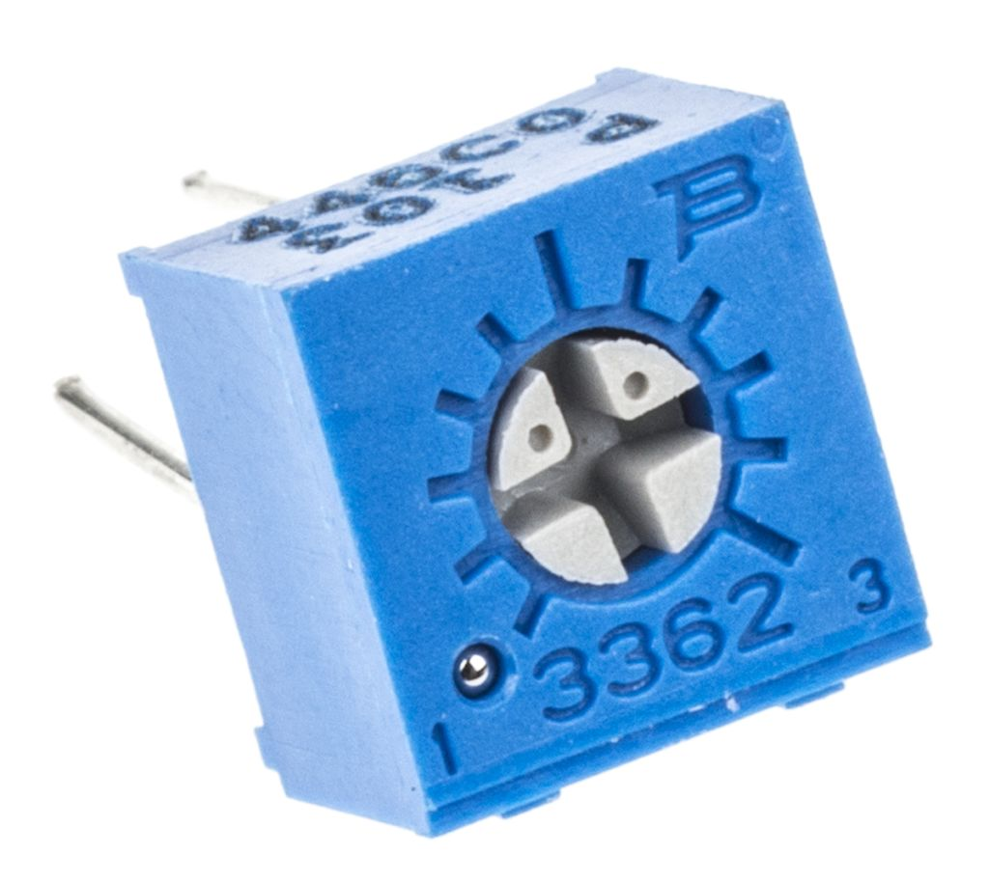
Reading analog signals
Let's start with a potentiometer
Pot for short
Used in
car stereos
Thermostats
speakers
Etc.
3 pins
Outer is grounded (symmetrical so it doesn't matter which side)
Other side pin is connected to high (5 v)
Inner pin is connected to ADC input – The output
As you turn the knob you are changing the resistance and thus the output voltage (by ohm's law) to any value between 0 v and 5 v

Slide 18
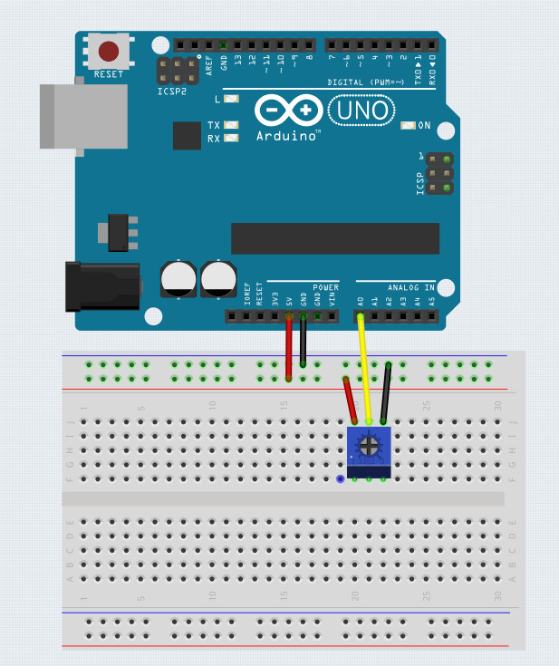
Lets wire up a circuit

Slide 19
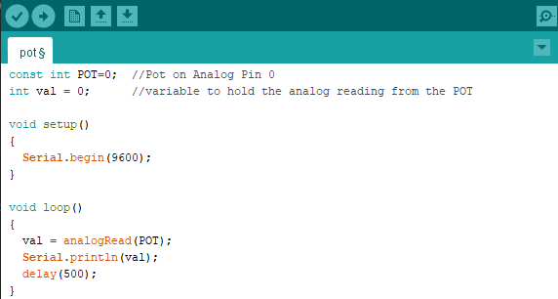
Download pot.ino from github and upload

Slide 20
Notice the new functions
analogRead()
This function reads the value of the analog pin connected to the Arduino
Serial.println()
This function prints to the Arduino IDE serial monitor
serial.begin()
In the setup section
Takes an argument that specifies the communication rate (baud rate)
Faster baud = more data in less time
Can induce transmission error
9600 is common value (and will be the standard we use)

Slide 21
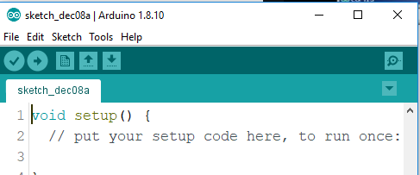
What you should see
The TX LED on the Arduino should be blinking every 500 ms
This indicated the Arduino is transmitting data
After launching the serial monitor you should see a window w/ numbers streaming by
Turning the dial the numbers should go up and down (corresponding to the position of the potentiometer)
One way goes toward 0
The other towards 1023
If you are getting “funky data” you need to ensure the baud rate is correctly set on the monitor
Serial Monitor

Slide 22
Use an analog sensor to sense temperature

Slide 23
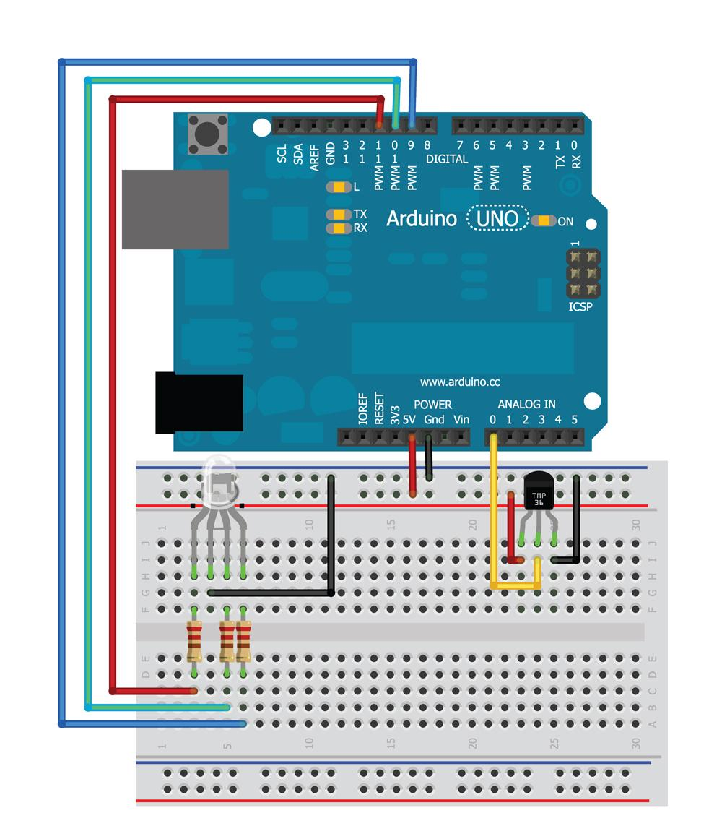
Wire it up
CAUTION!
Flat side of TMP36
faces down!

Slide 24
Before we can begin
We need cut offs
Using the same concepts as before we can find
Launch the sketch from before and see what “room temp” corresponds to
When writing this 20⁰ C was about 143 (these will be different for you)
Do a bit of math
5V / 1024 is 0.00488. So for every 0.0048V you get 1 DAC value increase.
20°/143 is 0.1399. So each degree Celsius correspondes to 0.1399/.0048 or ~30 DAC values
So to make the green LED light turn on, subtract 60 DAC values and add to the code
To make the RED LED light turn on, add 60 DAC values and add to the code

Slide 25
Try it yourself first
Goal to get to
Try to write a code that
When the temperature is with in “room temp” ± 2 ⁰C the led is Green
If the temp is lower than that the LED is Blue
If the temp is higher than that the LED is Red

Slide 26
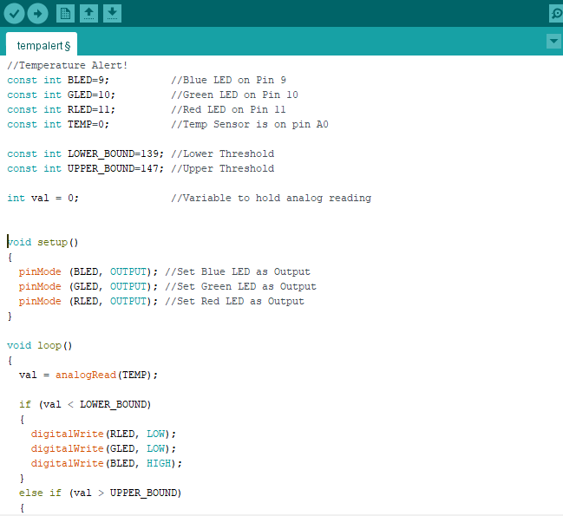
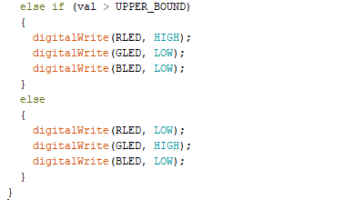
Download tempalert.ino from github

Slide 27
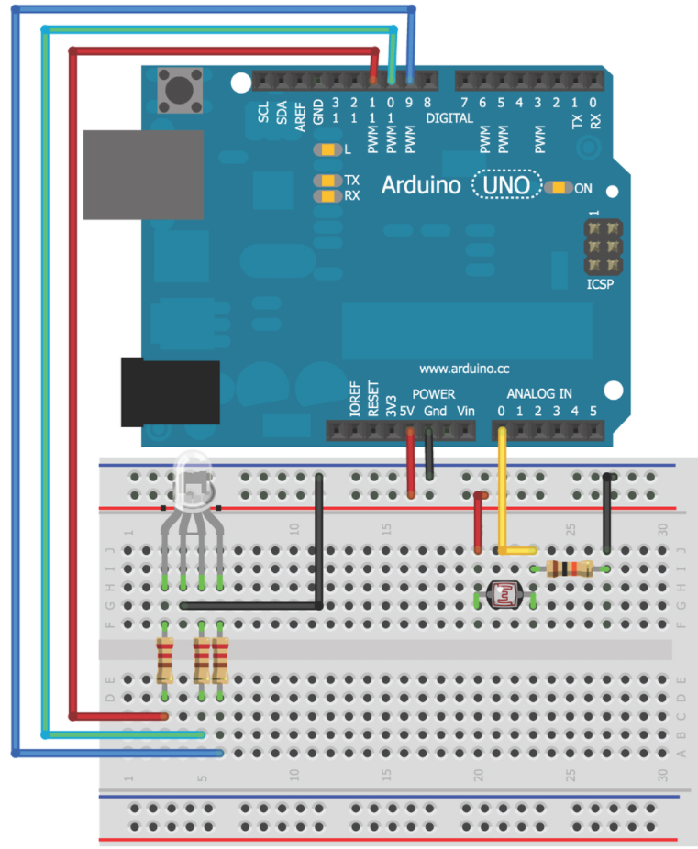
Add the Photoresistor
Insert the Photo Diode into Analog In 0

Slide 28
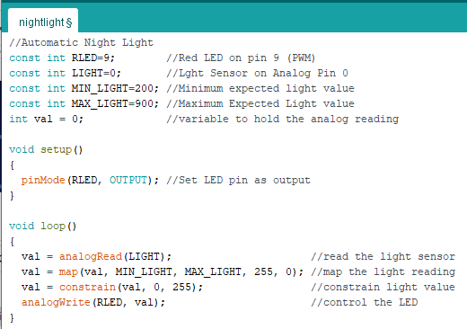
Download nightlight from github

Slide 29
New function
map()
Output = map(value, fromLow, fromHigh, toLow, toHigh)
Value - the information you start with
Most recent reading from analog input
fromLow and fromHigh
Input boundaries
Min and Max brightness
toLow and toHigh
Values you want to map to
255 and 0 (swapped to turn off the light when bright)
constrain()
constrain(value, min, max)
Constrains the value given between 2 values
If the photo resistor measured to high you would pass below 0 (its inverted to turn off in light)

Slide 30
Stay tuned
Arduino 3 will cover Motors and Servos.
We’ll use Motors, H-bridges and Servos!

